Slide 1
Corrective Action Review for Calibration Meeting (March, 2014)
V 1.0

Slide 2
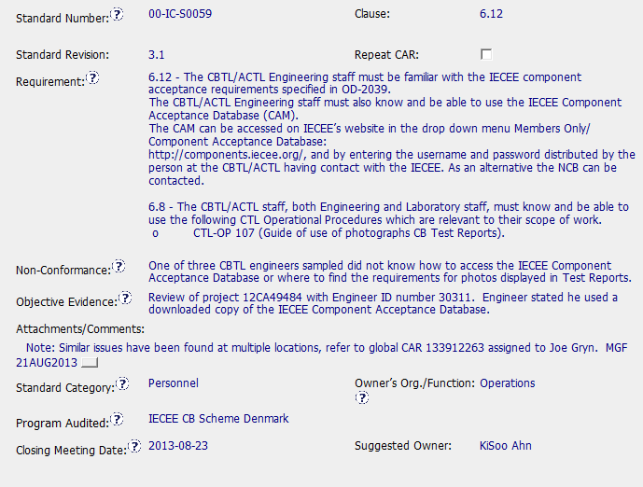
Observation CAR 133912331

Slide 3
Observation CAR 133912331
Simple, brief action appropriate to magnitude of issue.
Reference to global CAR for more systemic issue.
Note from C Allison: Be sure to include references to other CARs in the CAR reference section:
Immediate response by admin; immediate verification after closure.
No wasted time and/or effort, considering scope of observation

